Slide 2
Brand archetypes
visual design
Duration: 45 mins
Session by: Nikhil lama, Ankit maurya

Slide 3
Brand archetypes
What is archetype
What is Brand Archetype
How Brand Archetype connects people
How companies use Brand Archetype
12 Types of Brand Archetype
Sample & Resources
Exercise
you should be able to understand:

Slide 4
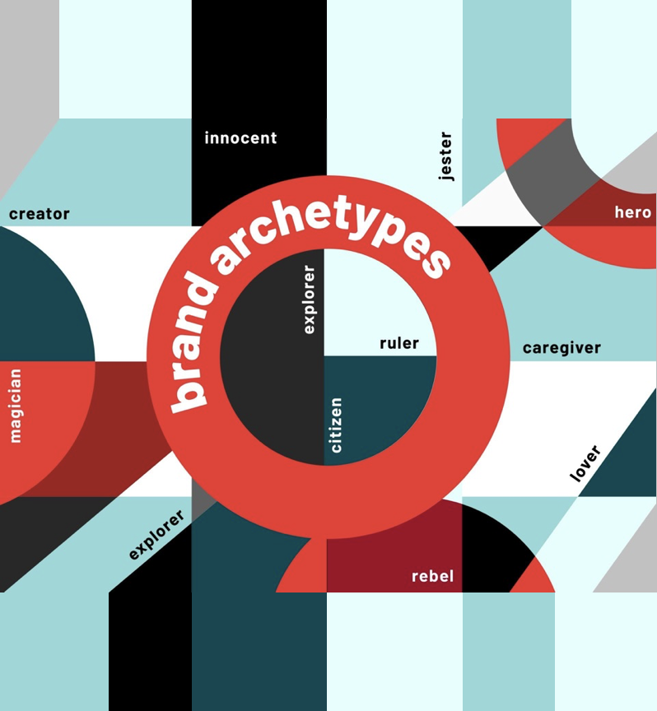
What is archetype?
Brand archetypes
“Universal collective patterns of the unconscious” that affect our self-image, our basic human desires, and our perceptions of others.
What is brand archetype?
Brand Archetype is a way of presenting a brand as a persona, thus making it more recognizable and relatable for consumers
Notes:
- In its simplest form, it means "original imprint or mold.” that initial pattern or essential aspects of a thing that determine its shape and nature.
- Carl Jung, a Swiss psychiatrist, 20th century, first person to bring the application of archetypes into modern psychology.
Regardless of where you are, what decade you may be in, companies and other well-known icons use these personalities to connect with people.

Slide 5
By aligning a brand with one of the universal patterns of personality, you can build a brand personality that connects with your target audience on a personal and emotional level.
How brand archetypes connect people
Notes:
Psychological research has personified various basic human desires creating a deeper connection with people, Brands uses these Personalities/ Archetypes to create symbols and stories that we already understand or recognize and relate to.

Slide 6
How companies use brand archetypes
Know your brand
Know your target
audience
Learn the archetypes
Develop the right mix
From persona:
Demographic data
Identify business objectives
(Sales, Marketing & Branding, Operations and Customer service)
Archetypal mix
Primary/secondary archetypes
From Persona:
Psychographical data
Attitudes, beliefs and values
of your target audience
Filter relevant archetype
Narrow down the list by
removing unrelated archetypes.
START
Brand’s vision/statement (Core Desire)
Finding right archetype
After evaluating your business goals and desires, including those of your audience, you should be able to find your right archetype!
Notes:
BRAND DISCOVERY
The four steps we discussed are part of a process called brand discovery.
The process calls for an extensive research and discovery process in order to build a brand.
you get to know your audience and then you evaluate the information you've gathered from both parties to build your brand.
Make use of the Persona, detailed out User’s attributes
Keep in mind that when it comes to finding your brand archetype, you have to keep both your brand and Audience’s desires in mind. A brand's success relies on the relationships they build with people.

Slide 7


Types of archetypes
visual design

Slide 8




Characteristics
The outlaw
Driving force
Revolutionary mindset
Oppose any form of rules
Driven mostly by anger
Liberation
Change
Revenge
Fears
Brand voice
Conformity
Complacency
Acceptance
Disruptive
Rebellious
Combative
Brands

Slide 9
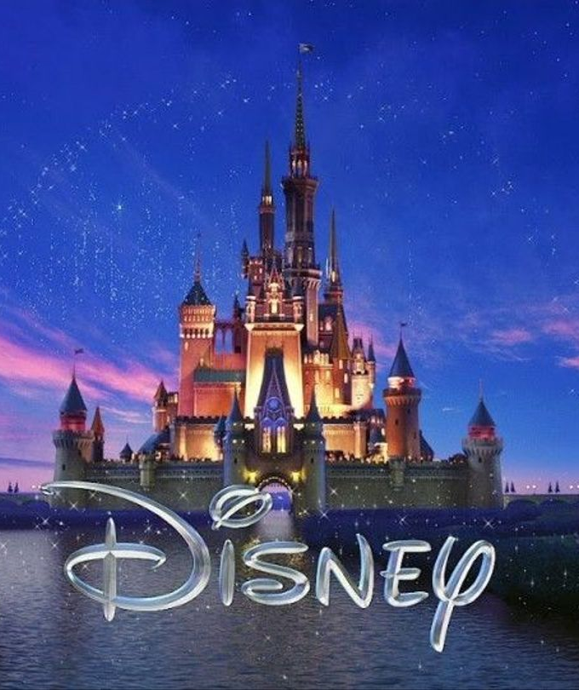



Characteristics
The magician
Driving force
Want to bend the laws of reality
Believe they have limitless imagination
Have thirst for knowledge
Transformation
Knowledge
Vision
Fears
Brand voice
Ignorance
Consequences
Doubt
Mystical
Informed
Reassuring
Brands

Slide 10




Characteristics
The hero
Driving force
Take pride in their work rate
Believe they are different from others
Want to ultimately conquer their fears
Growth
Mastery
Courage
Fears
Brand voice
Cowardice
Downfall
Incompetence
Brave
Honest
Candid
Brands

Slide 11


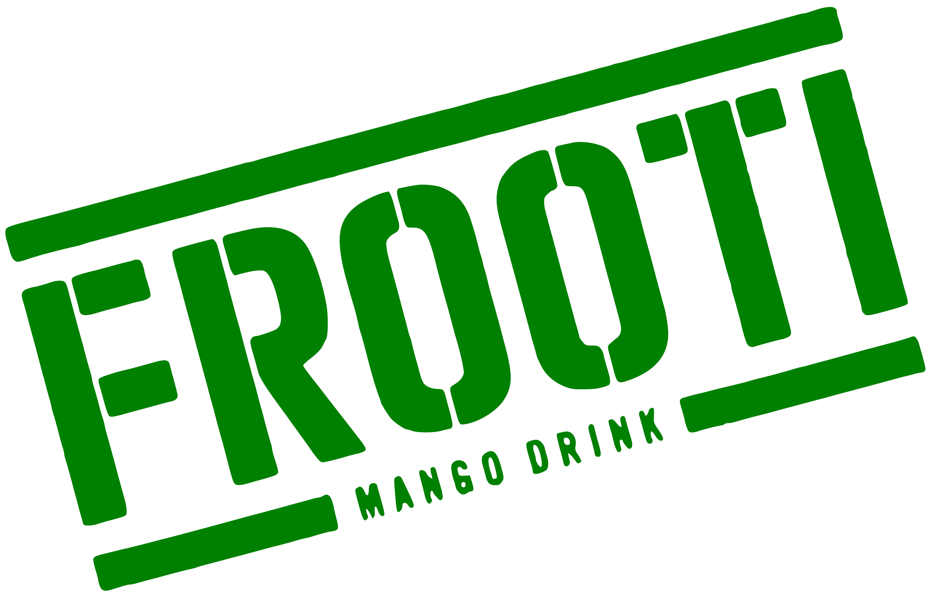

Characteristics
The jester
Driving force
Optimistic at heart
Don’t take themselves too seriously
Stick to their child-like behavior
Fun
Happiness
Togetherness
Fears
Brand voice
Sadness
Gloom
Boredom
Fun loving
Playful
Optimistic
Brands

Slide 12
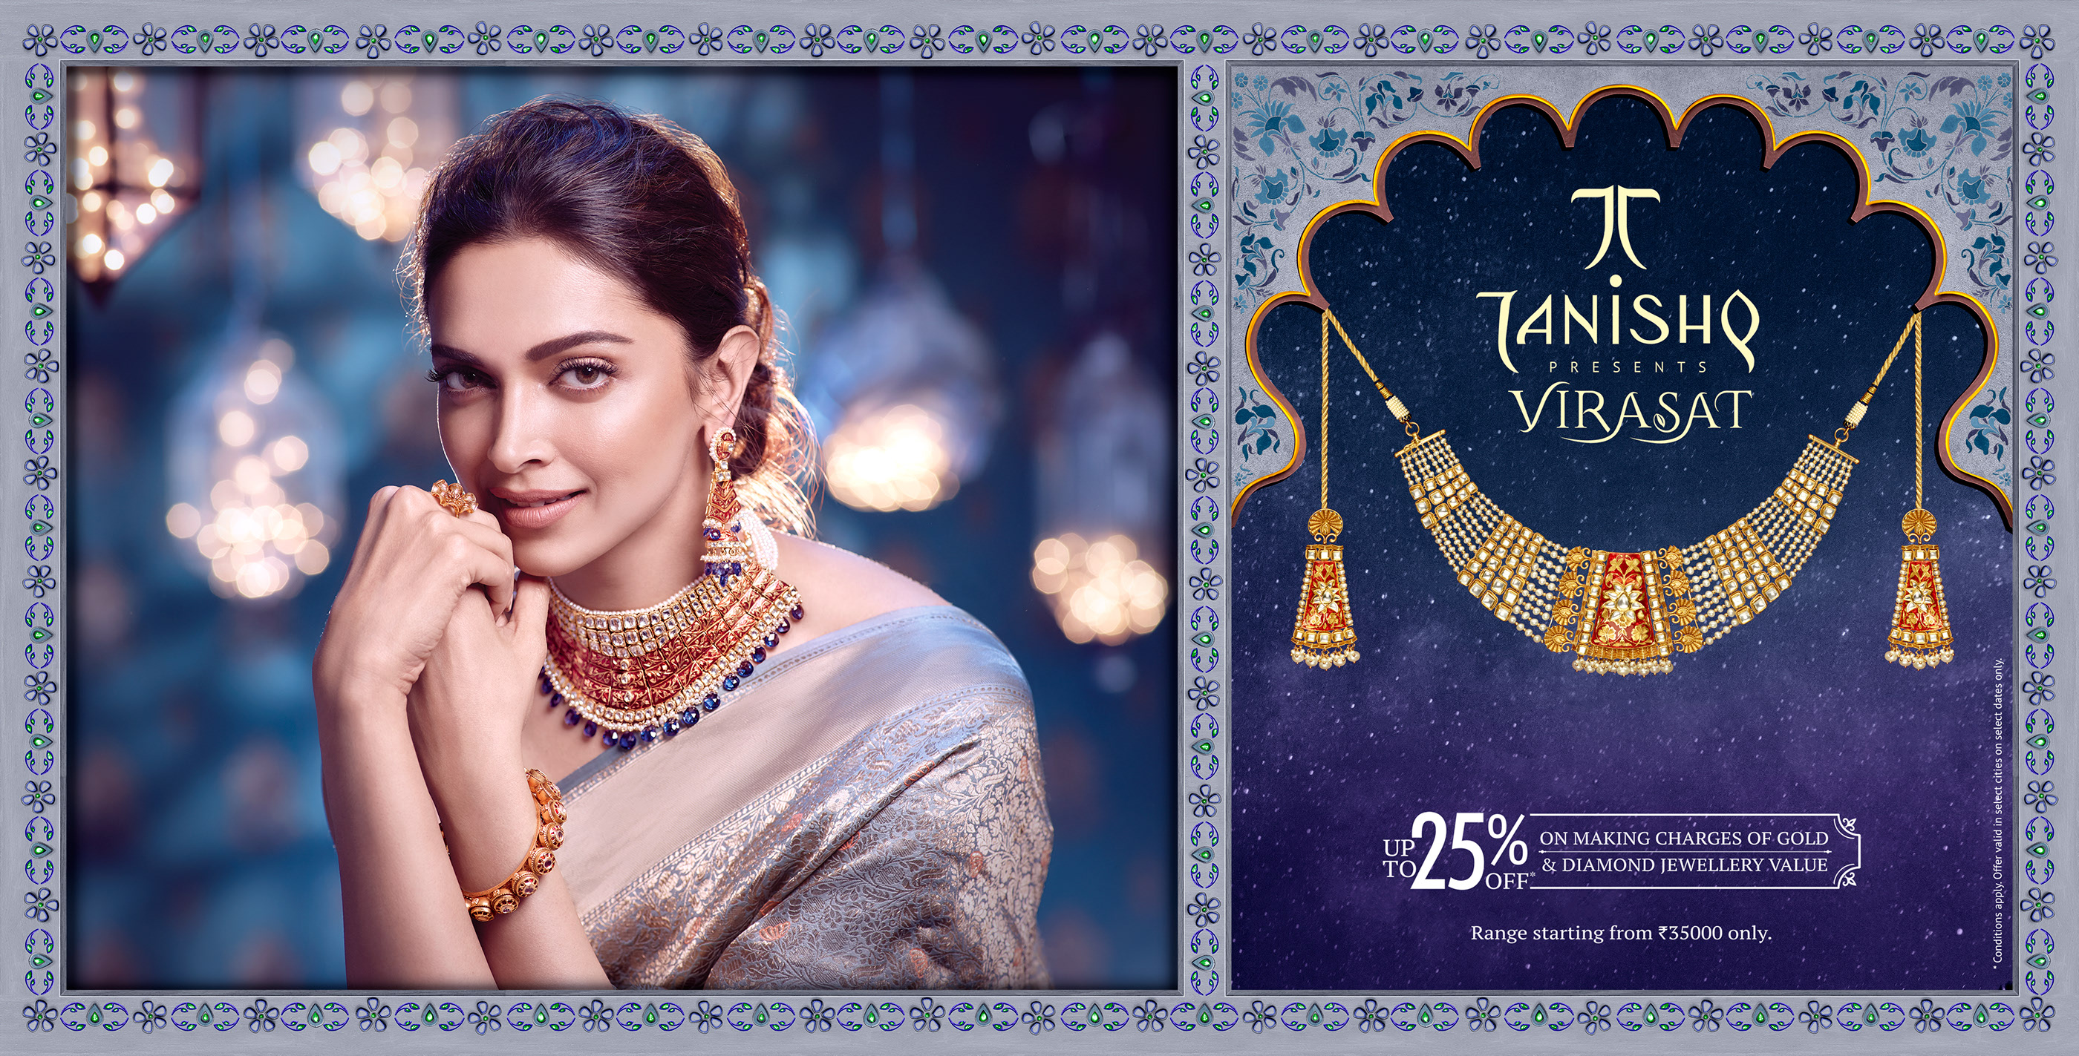







Characteristics
The lover
Driving force
They desire to be desired
Driven by intimacy
Want high emotional & physical appeal
Affection
Love
Sensuality
Fears
Brand voice
Loneliness
Isolation
Rejection
Sensual
Empathetic
Soothing
Brands

Slide 13




Characteristics
The everyman
Driving force
They want nothing but to simply belong
Strive for little more than normal
Funny & easy to talk to
Connection
Togetherness
Equality
Fears
Brand voice
Standing out
Isolation
Hostility
Friendly
Humble
Authentic
Brands

Slide 14
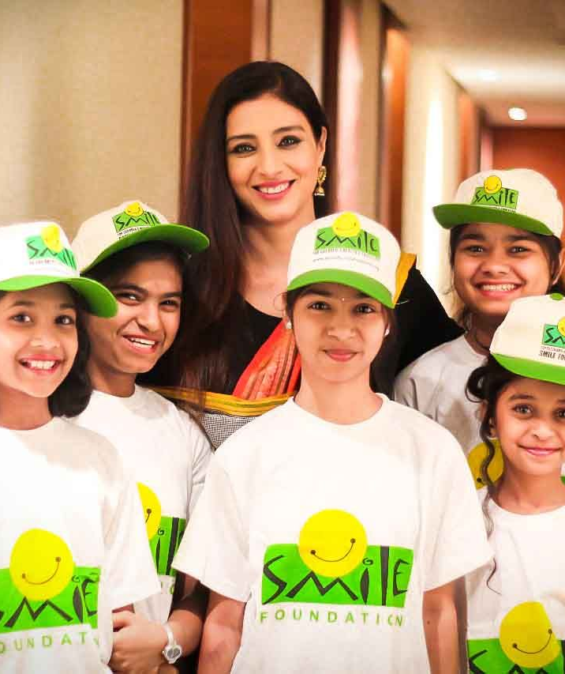



Characteristics
The caregiver
Driving force
Selfless personality
Dislike being patronized
Want to protect & care for everybody
Support
Help
Service
Fears
Brand voice
Anguish
Helplessness
Neglect
Caring
Warm
Reassuring
Brands

Slide 15
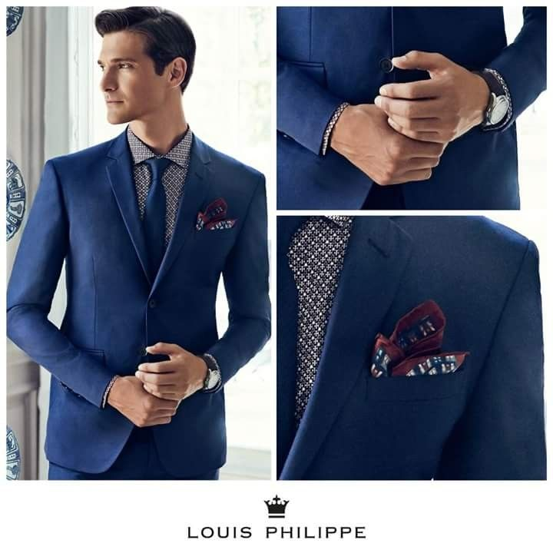

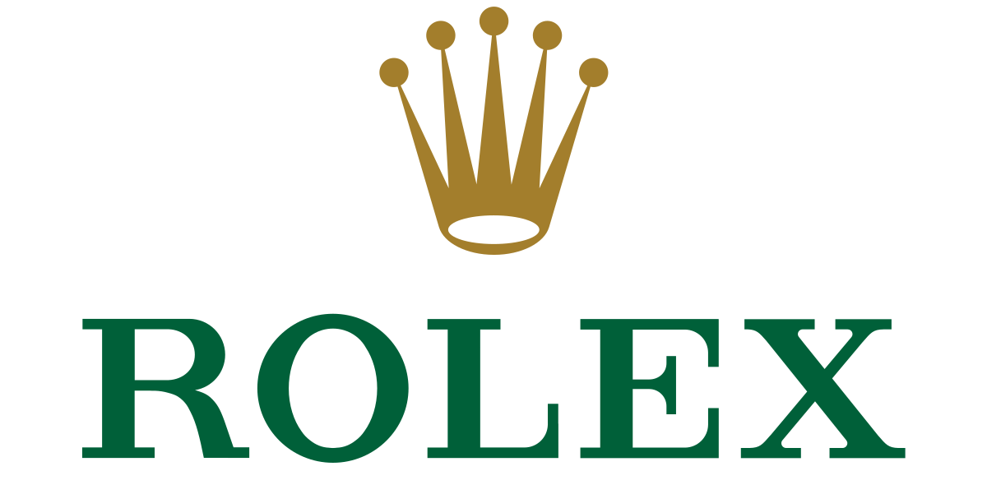

Characteristics
The ruler
Driving force
Desire control
Carry bold & confident personality
See themselves at top of the food chain
Power
Prosperity
Status
Fears
Brand voice
Weakness
Failure
Poverty
Commanding
Refined
Articulate
Brands

Slide 16
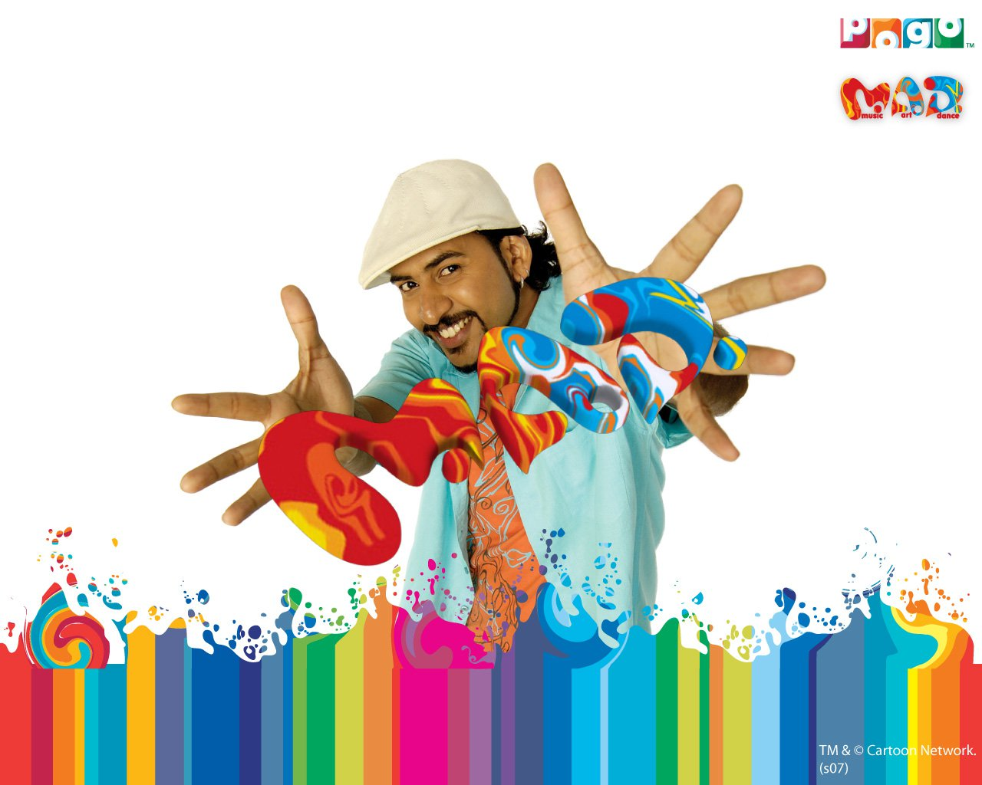


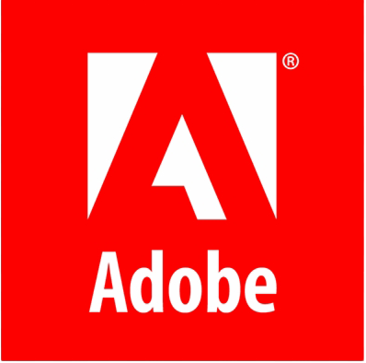
Characteristics
The creator
Driving force
Desire to create something new & beautiful
Have innovation at the heart
Strong desire to express their creativity
Creation
Originality
Self-expression
Fears
Brand voice
Stagnation
Duplication
Familiarity
Inspirational
Daring
Provocative
Brands

Slide 17
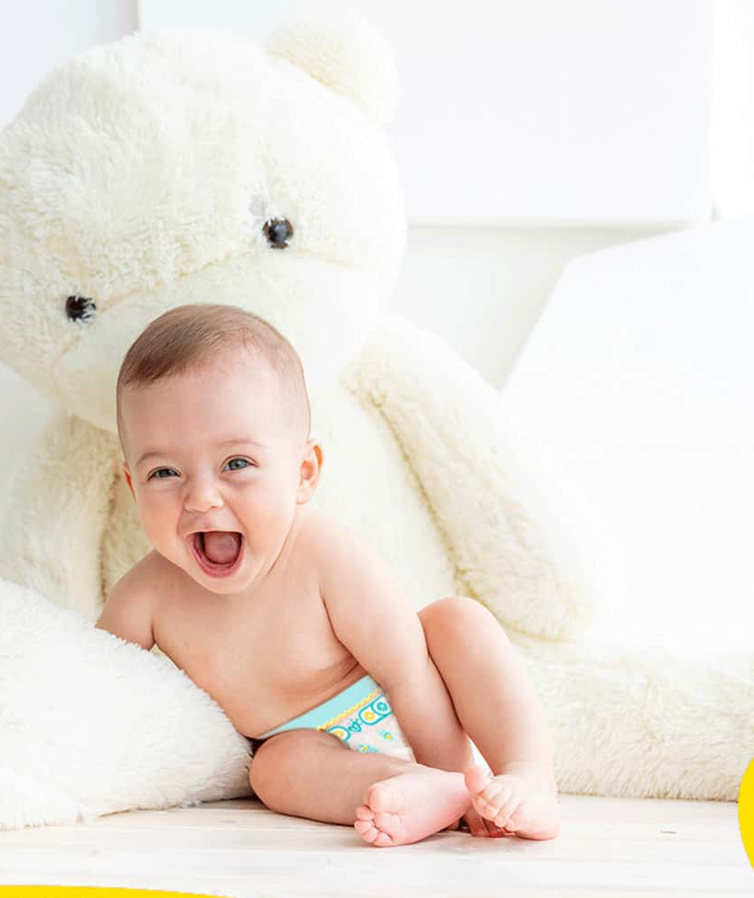




Characteristics
The innocent
Driving force
Simple personality with an optimistic attitude
Want everyone around them to be happy
Don’t hold on to any kind of grudges
Health
Wholesomeness
Simplicity
Fears
Brand voice
Anguish
Complexity
Deceit
Optimistic
Honest
Humble
Brands

Slide 18
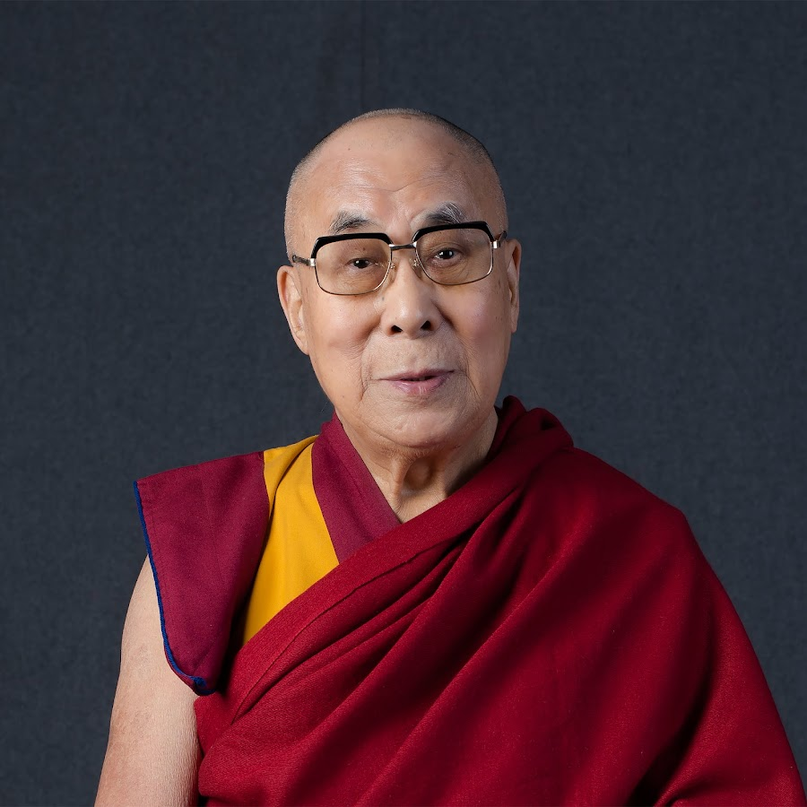

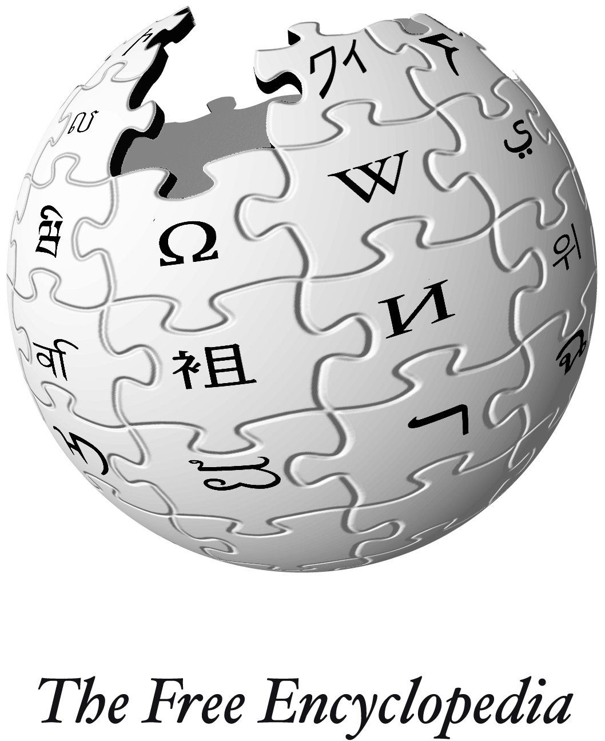

Characteristics
The sage
Driving force
Seeker of knowledge, truth & wisdom
Want to share their wisdom with the world
Expertise
Intelligence
Answers
Fears
Brand voice
Ignorance
Powerlessness
Misinformation
Knowledgeable
Assured
Guiding
Brands

Slide 19
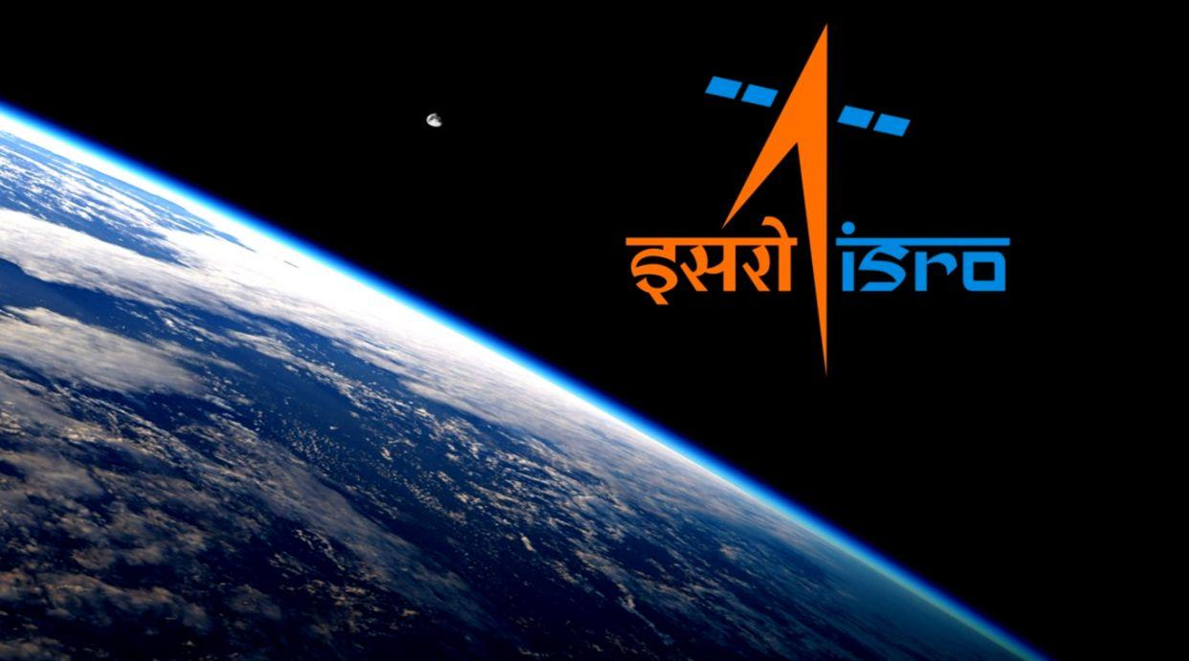
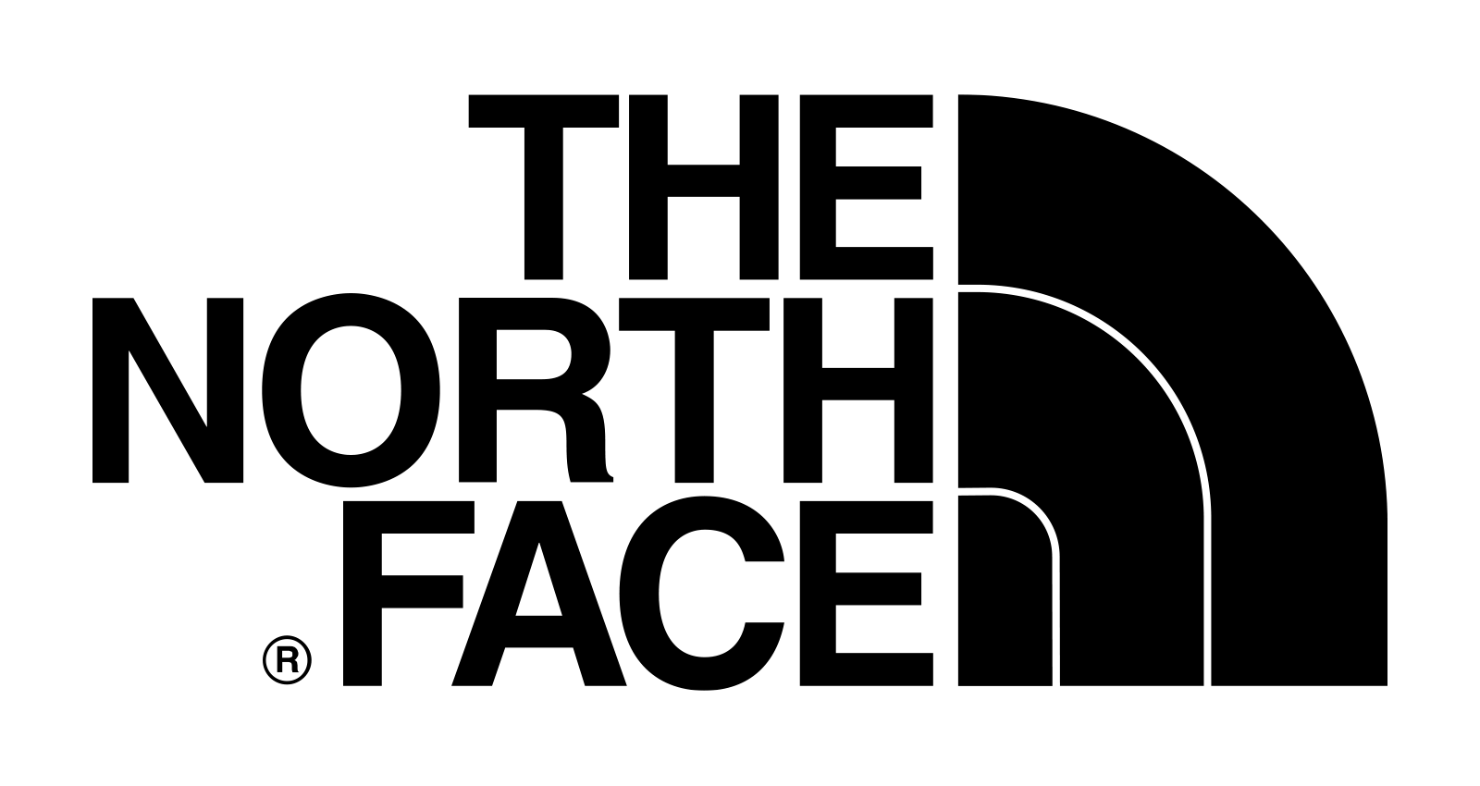


Characteristics
The explorer
Driving force
Push themselves out of their comfort zone
Always driven to exploring new places
Adventure
Exploration
Self-discovery
Fears
Brand voice
Confinement
Immobility
Caution
Exciting
Fearless
Daring
brands

Slide 20

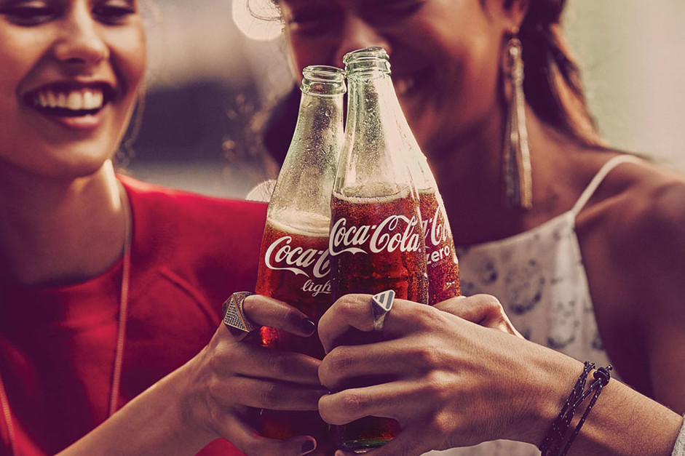
Archetype mix
Develop the right mix
Primary Archetype (Innocent)
Also known as the Core Archetype, it should contain a minimum of 70% of your brand personality.
Secondary Archetype (Magician)
Also known as the Influencer Archetype, it should contain up to 30% of your brand personality.
Coca Cola showcases ‘Innocent’ archetype with brand messages like “It’s a real thing” and “open happiness” as it depicts moments of simplicity & happiness
Coca Cola is more than just a drink as it portrays ‘Magician’ archetype. It lets you create memories by bringing people together
Notes:
Innocent as Primary Archetype: https://neuroflash.com/blog/coca-cola-brand-marketing-strategy/
History of all coca-cola slogans: https://www.coca-colacompany.com/company/history/history-of-coca-cola-advertising-slogans#:~:text=about%20Coca%2DCola-,The%201906%20slogan%2C%20%22The%20Great%20National%20Temperance%20Beverage%2C%22,Million%20a%20Day%22%20from%201925.
Refreshing Magic of Cola: https://skoclarity.com/refresh-the-world-make-a-difference-how-coca-cola-uses-archetypes/

Slide 21
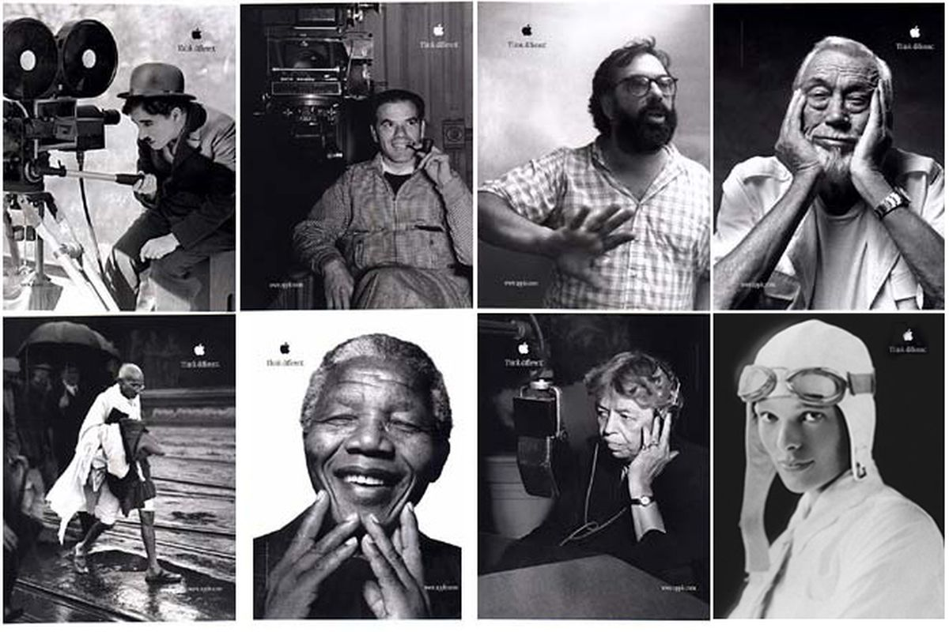
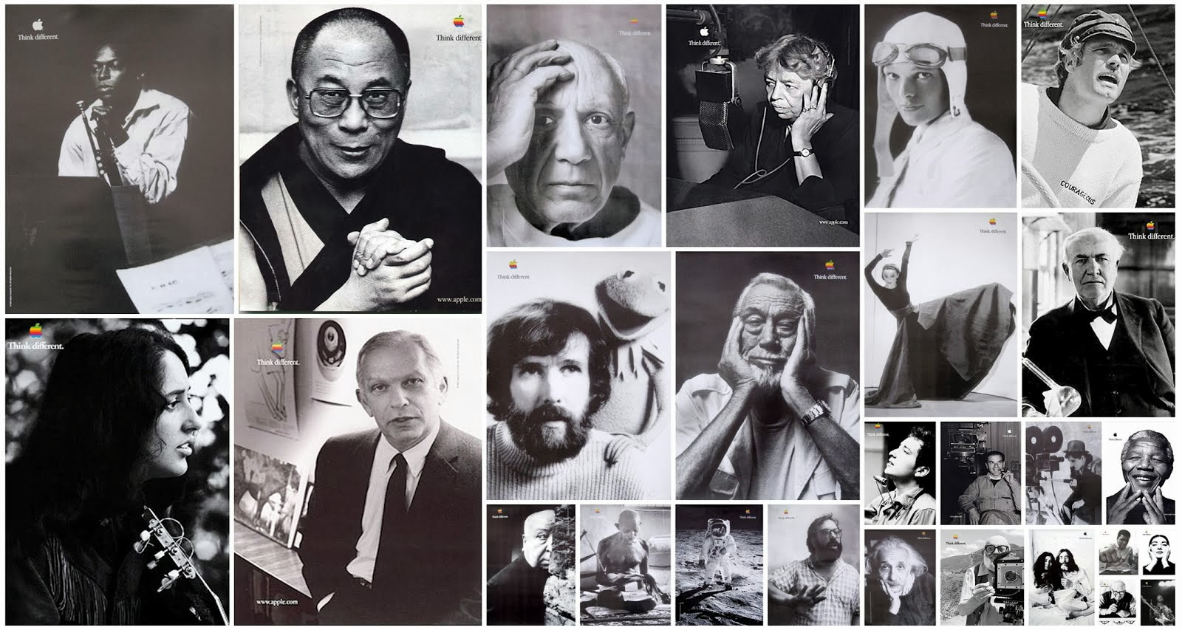
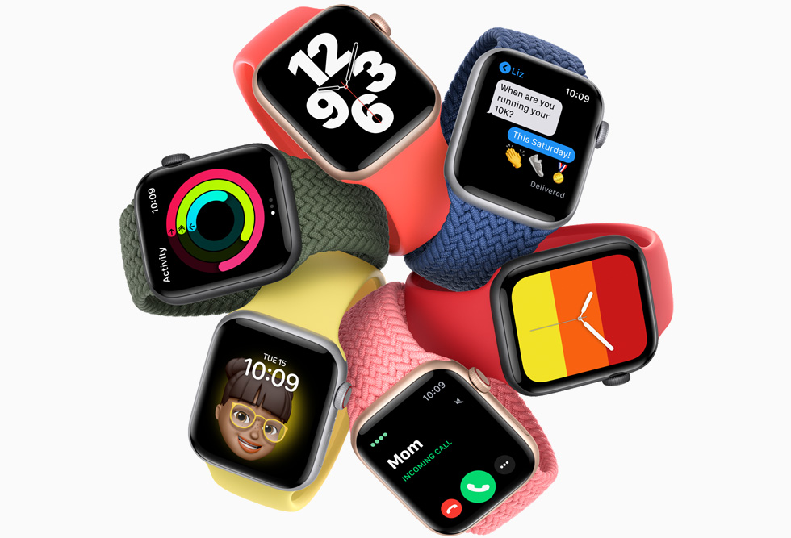
To make the best products on earth, and to leave the world better than we found it
The creator archetype of apple
Vision
Brand Persona
Portray themselves as:
One who sees things differently
Not fond of rules
No respect for status quo
Colours
Designs
Design Approach
Simple & Minimalistic
Notes:
Apple’s Design System: https://developer.apple.com/design/human-interface-guidelines/guidelines/overview/
Apple Brand’s Case Study: https://cultbranding.com/ceo/apple-archetype/#:~:text=The%20Archetype%20of%20The%20Apple&text=The%20apple%20has%20always%20been,their%20expulsion%20from%20the%20garden.

Slide 22
Hope this session helped you gain high level understanding of the relationship between brands and their consumers
Notes:
Psychological research has personified various basic human desires creating a deeper connection with people, Brands uses these Personalities/ Archetypes to create symbols and stories that we already understand or recognize and relate to.

Slide 23
Some useful resource links
Business Branding with Personality - Build an Authentic Brand: Course Link
How brand archetypes make your brand memorable: Article Link
Evolution of brand archetypes: Playlist Link

Slide 24
Exercise
01
02
Pick any brand
Define the archetype
Read their vision and mission statements
Go through their digital platform, physical products, etc
Observe their color palette, typography, imagery, shapes, etc.
Observe their brand’s voice & tone
Gain an insight into their target user base
Write down your brand’s characteristics, brand voice, fears & motivation
Match your findings with the existing archetypes that we studied
Try to determine the appropriate archetype mix

